Slide 1
Homework 4 Presentation

Slide 2
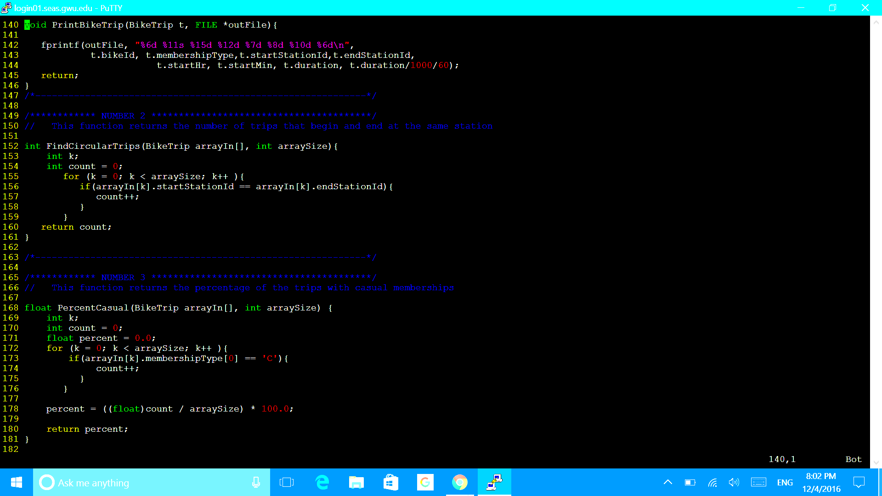
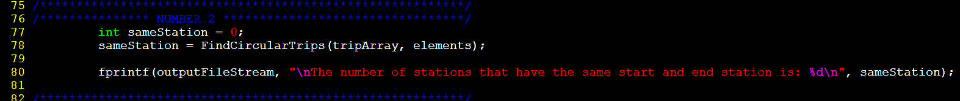
Question 2
Write a function that returns the number of trips that began and ended at the same station, print this number to the output file with a descriptive message
In main:

Slide 3
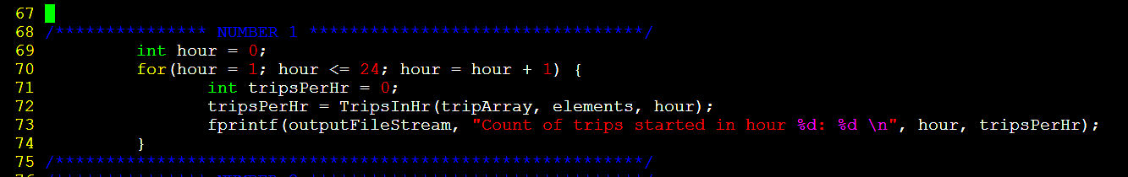
Question 1
Using the function TripsInHr( ) that is already in the program, write a for loop that prints the number of trips that begin in each hour

Slide 4
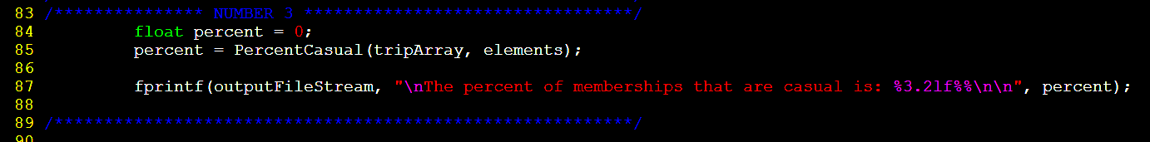
Question 3
Write a function that returns the percentage of the trips with casual memberships, print this percentage to the output file with a descriptive message
In main:

Slide 5
Dian Jing
How I contribute to the project:
I wrote question 4, find the highest times of trip, and question 5 calculate the average duration.
The advantages programming in a group:
We can share knowledge and make up everyone’s shortcoming. Moreover, It is more efficient than work alone, because we can split the heavy work.
The challenges programming in a group:
The flexibility of time of each group member. And the allocation of work.

Slide 6
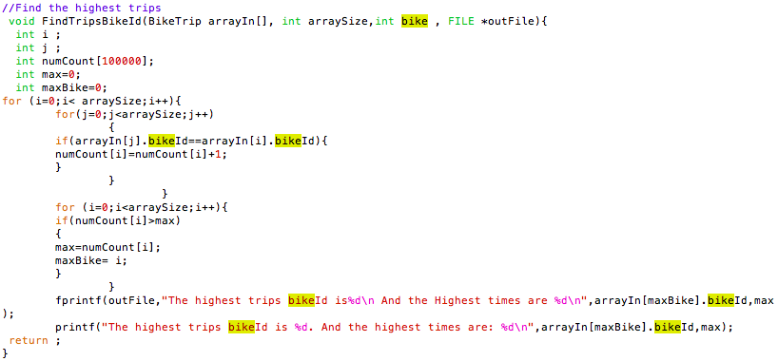
Question 4

Slide 7
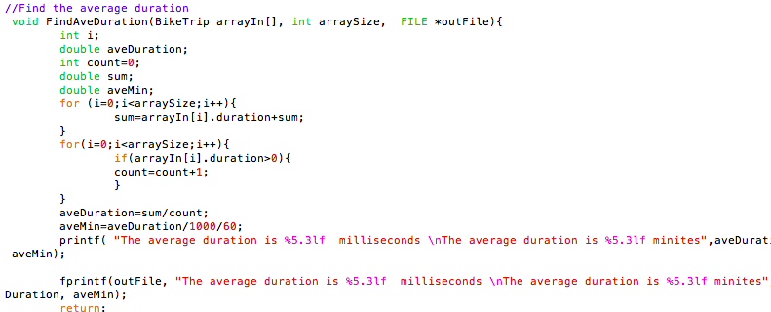
Question 5

Slide 8
Min Yang
How I contribute to the project:
I wrote question 6, find the number of trips in a certain time interval
The advantages programming in a group:
We are able to split the work and work on the code and knowledge we are comfortable with
The challenges programming in a group
It takes a while to combine the program from each other’s laptop, and arranging the long code in a readable way

Slide 9
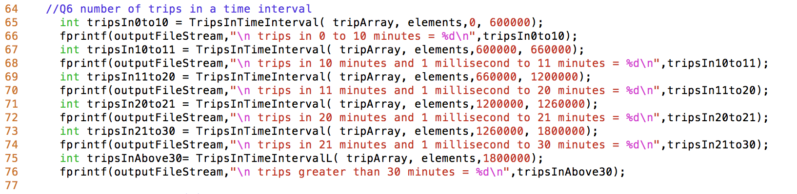
Question 6

Slide 10
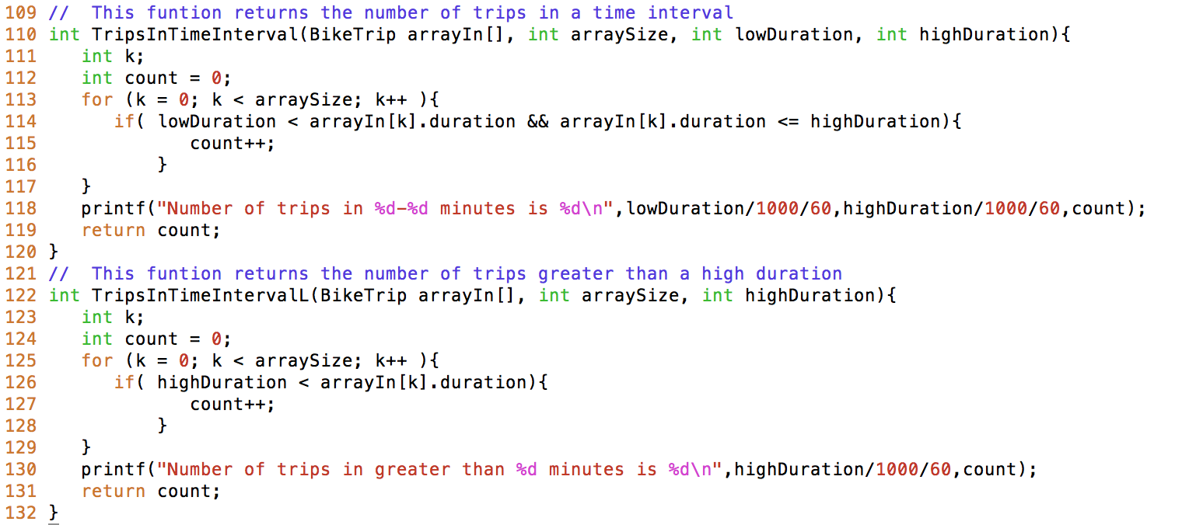
Question 6

Slide 11
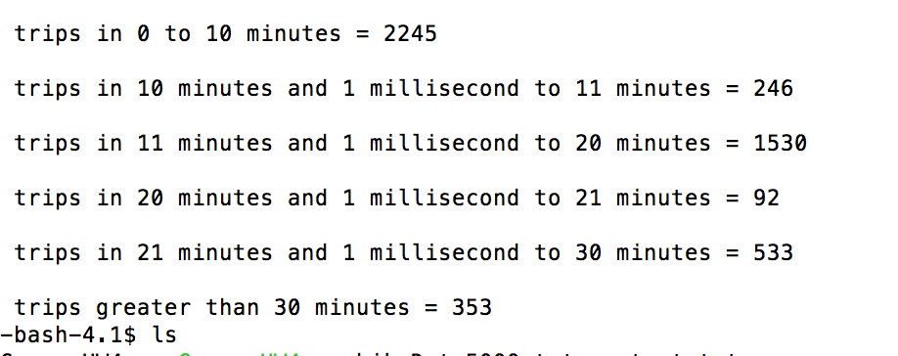
Question 6

Slide 12
Alexis Kolecki
How I contributed to the project:
I wrote the code for question 7.
Benefits of programming in a group:
It was helpful to break up the long assignment and learn how others would write a code compared to how you would write a code. Their are different approaches to a problem.
Challenges of programming in a group:
The challenges were combining all of our codes into one program and trusting each other to each complete our portion of the code.

Slide 13
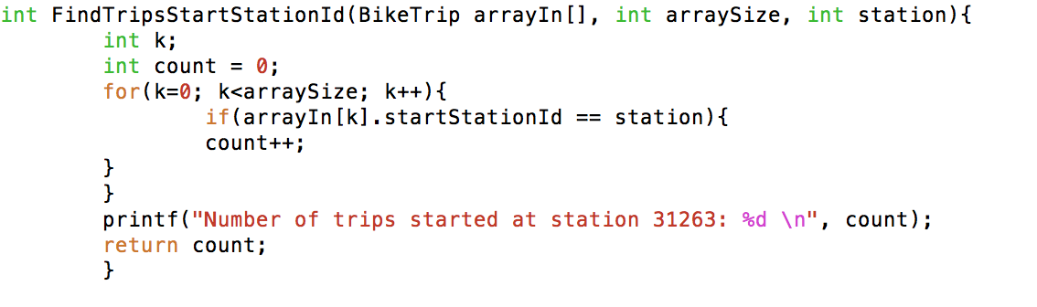
Question 7 Part a
Notes:
24

Slide 14
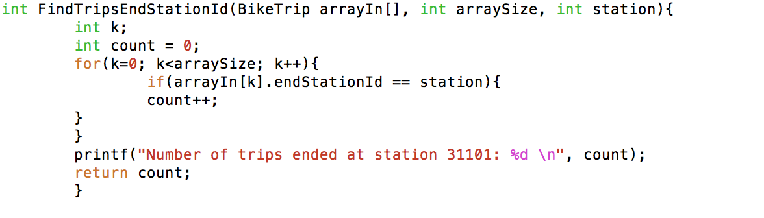
Question 7 Part b
Notes:
73

Slide 15
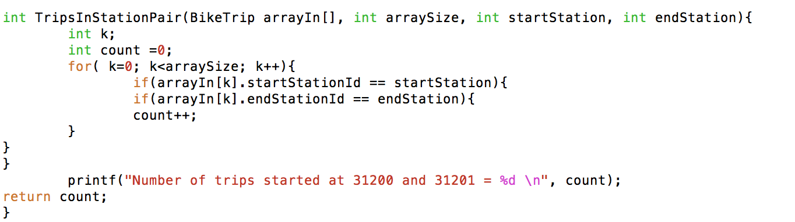
Question 7 Part c
Notes:
8

